Slide 1
Teacher Comment Project
Corbet’s Comments for Christian Lives
James, Brian, Lewis, Annie
Notes:
Present a four slide presentation: an example of an excelling student’s comment, an
example of a struggling student’s comment, a discussion of the attributes you used in your CSV
file, and any struggles you ran into + any unique things about your program

Slide 2
An Excellent Student’s Comment
Brian has been highly engaged in class, always voicing the thoughts, and very diligently working with others. He also pays excellent attention in class, very well prepared for each class, and has a terrific understanding of the topics we are covering. He did a good job on the first quiz, showing a good command of basic terminology for the Christian religion. His first paper, comparing two gospels, did an effective and quite thorough job of drawing out differences. His second paper, on the diversity of early Christianity, used good organization and had a strong focus throughout. His current grade is an A. I have so much respect for the avidity with which he dives into the religion learning, and I hope he'll continue exploring the grand world of Christian Lives.
Notes:
Brian

Slide 3
A Struggling Student’s Comment
James has been moderately engaged in class, never voicing the thoughts, and rarely working with others. He also pays insufficient attention in class, barely prepared for each class, and has a good understanding of the topics we are covering. He had trouble with the first quiz, which covered basic terminology for early Christianity. I would recommend that he come meet with me if they do not understand a subject. His first paper, comparing two gospels, did an effective and quite thorough job of drawing out differences, though he had some trouble keeping a single, specific focus. His second paper, on the diversity of early Christianity, found and implemented strong evidence into his essay, but it was less focused on the different interpretations of Jesus than it might have. He had 22 tardies, which I consider to be excessive. He still has not turned in the Da Bible assignment. His current grade is a C. I'm disappointed at James's attitude in my class this semester. I believe he could have done better if he put in more work and time.
Notes:
James

Slide 4
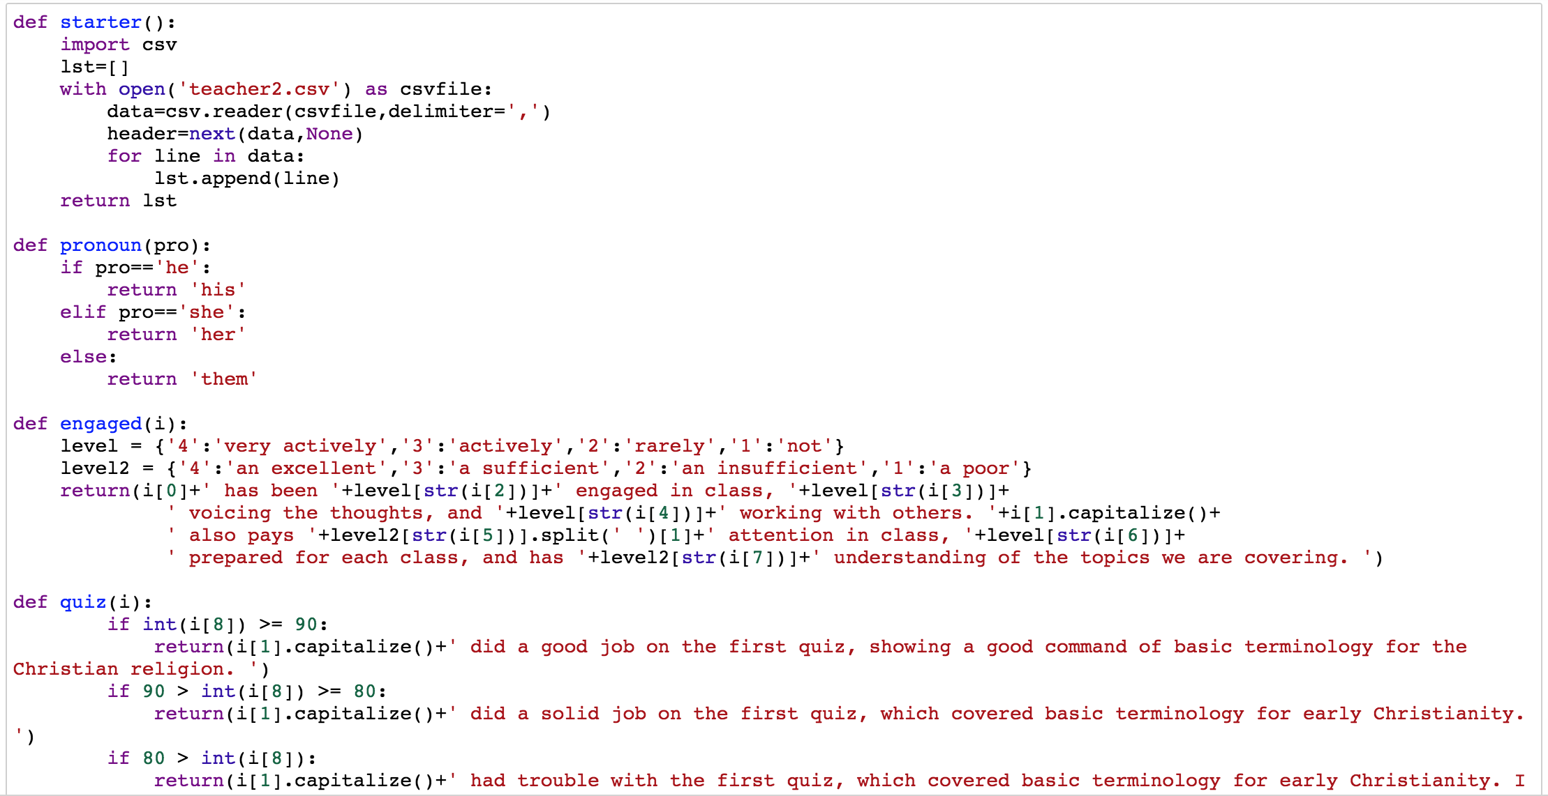
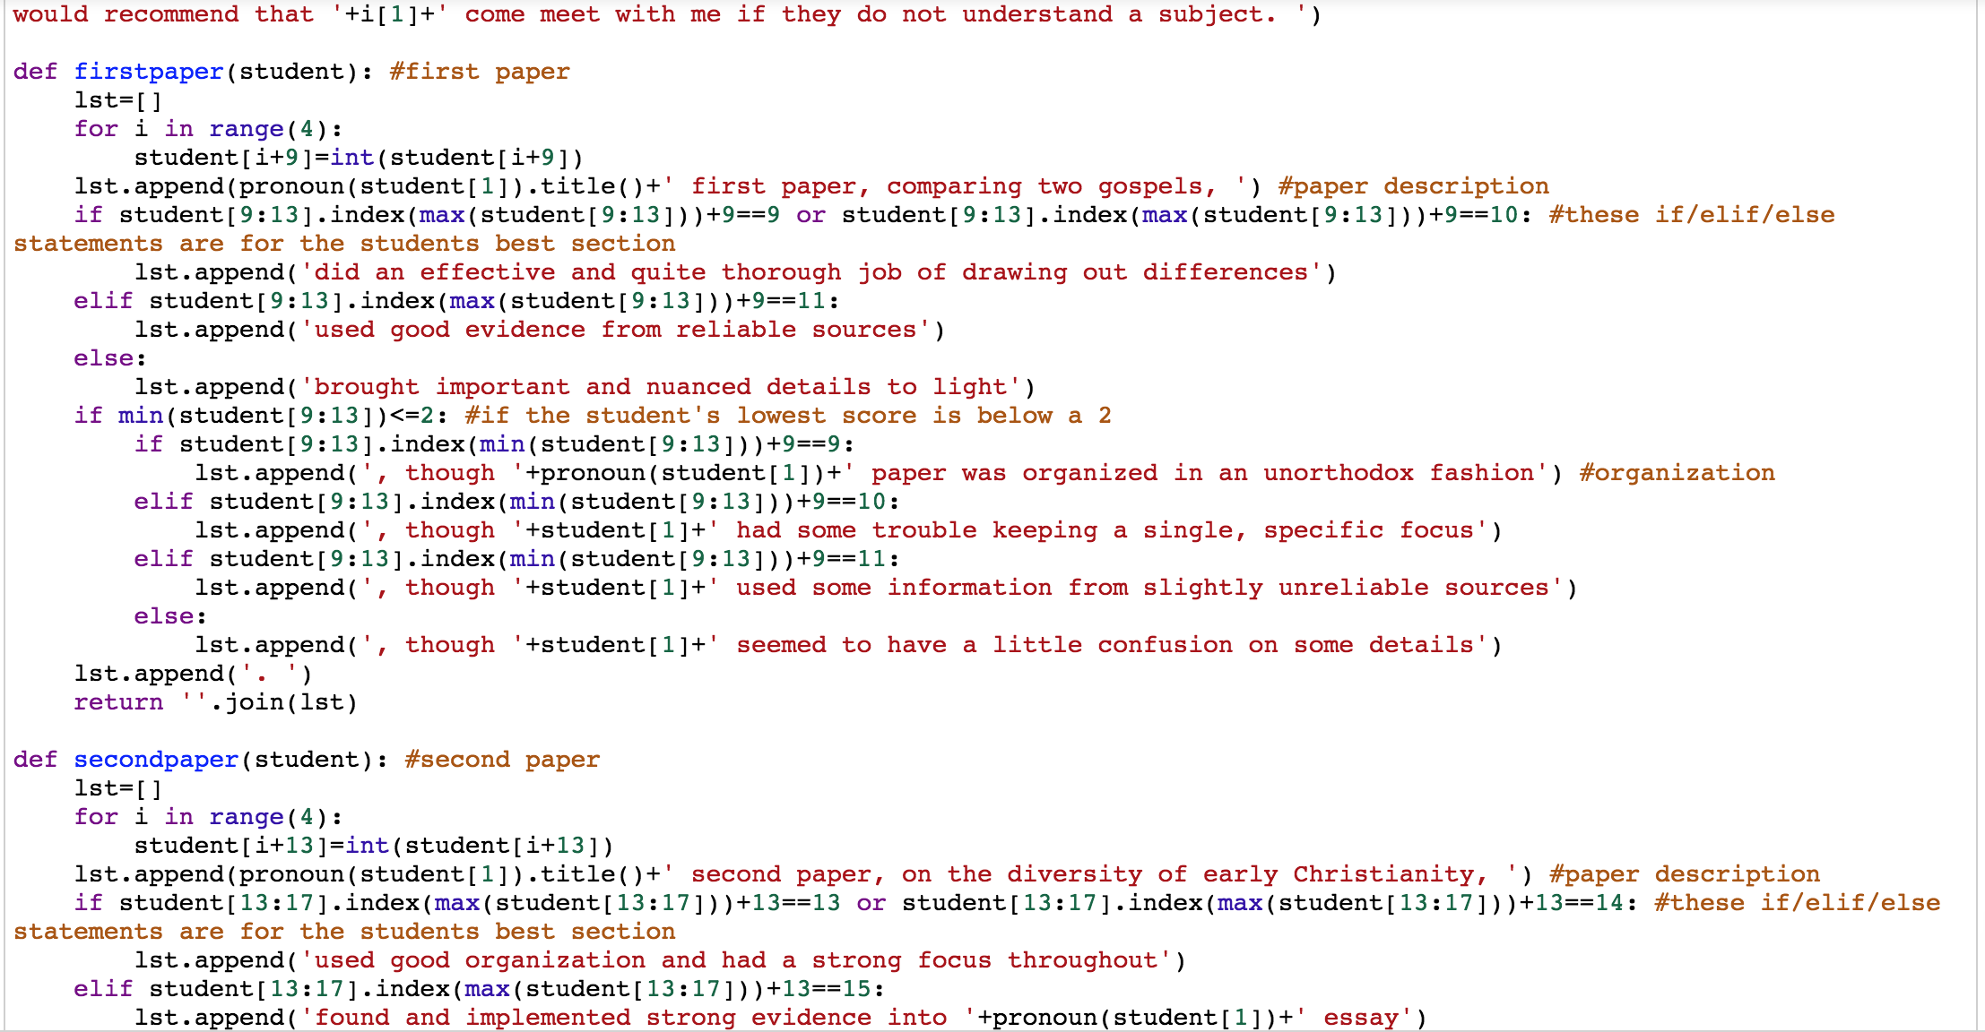
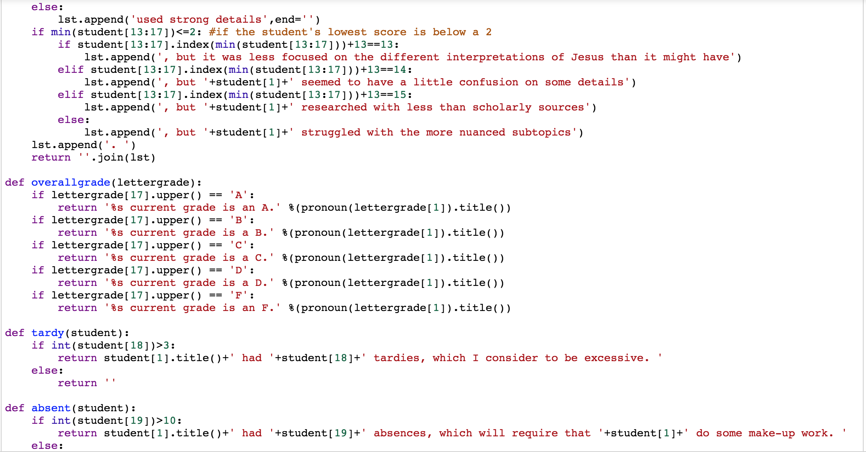
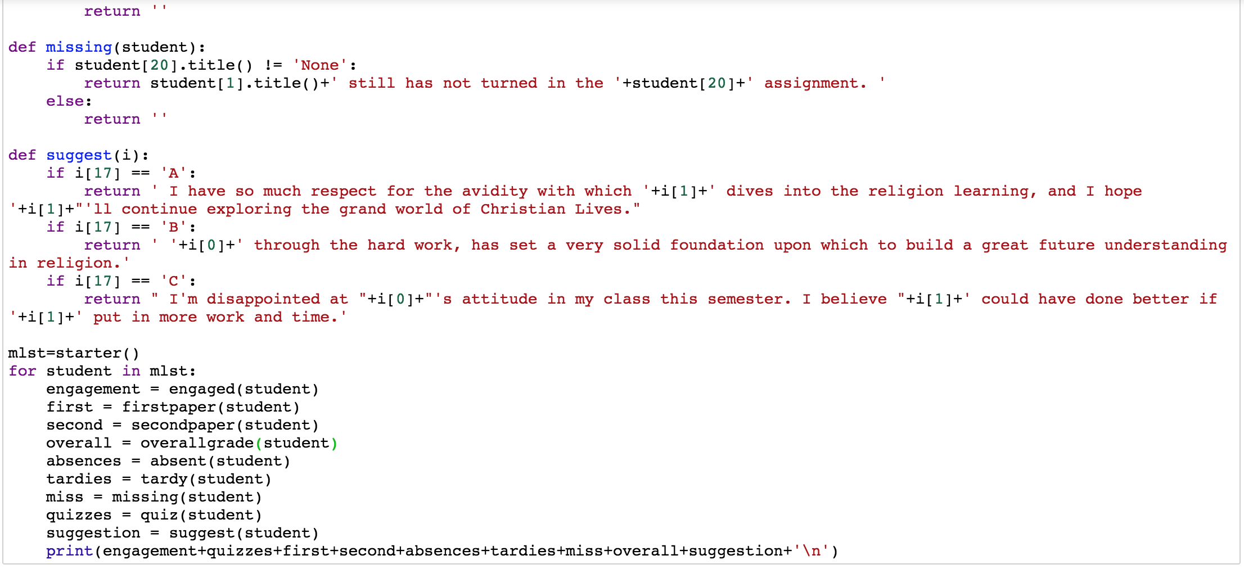
Group Members’ Attributes
James - Write the code for tardies, absences, and missing assignment section; put everyone’s code together
Brian - Write and debug the code for the written paper section
Lewis - Write the code for the first paper section
Annie - Write the code for the engagement and suggestion section; put the slide together
Notes:
Annie

Slide 5
Struggles and Unique Things about the Program
Since we had two team members not present during the week of work, it was hard for us to communicate and thus integrate all the codes.
When a function can only return certain things but not others, it also took a long time to debug or find an alternative way to write the code.
Our program is easy for the teacher to use and the comments it generate are comprehensive and personal for the student to see. There are in total 21 columns for the teachers to fill out, in which 14 columns are to be put in numbers from 1 to 4 that suggest the various aspects of the student’s engagement in class or his/her skills in writing the papers. At the same time, the comment also includes a suggestion from the teacher in how the student could have done better or how the student can move forward in the future.
Notes:
Lewis

